Slide 1
Dallas To Houston Bullet Train Is Electric
Texas Bullet Train
Notes:
The presentation will cover extensively various aspects about the Dallas to Houston bullet train is electric. This will help to have a clear understanding of the same.

Slide 2
The Station And Routes That The Train Will Follow
The station will be located at Dallas around the Cedars area which is found south of downtown Dallas.
The train will then stop one more time at Brazos valley where another station will be constructed around Texas 90 and state Highway 30 approximately 20 miles east of college station (Babones, 2018).
After there the train will then proceed to Houston near the highway interchange near the west loop,290 and I-10.
Texas central needs 8000 acres of land for the project to be successful
Current tracks will not be used as they are not compatible ,they have to construct the new ones.
Construction of the project will cost $12 billion and it will move with the highest speed of 300km/h.
Notes:
There are a number of routes that the train will follow. The station will be located at Dallas around the Cedars area which is found south of downtown Dallas. The train will then stop one more time at Brazos valley where another station will be constructed around Texas 90 and state Highway 30 approximately 20 miles east of college station (Babones, 2018).
After there the train will then proceed to Houston near the highway interchange near the west loop,290 and I-10. Texas central needs 8000 acres of land for the project to be successful Current tracks will not be used as they are not compatible ,they have to construct the new ones.
Construction of the project will cost $12 billion and it will move with the highest speed of 300km/h.

Slide 3
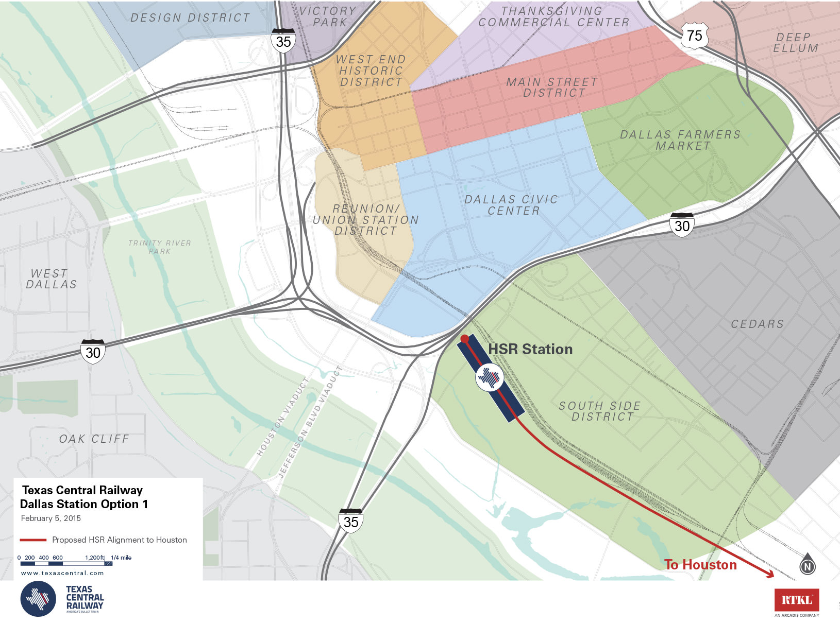
The Dallas Station

Slide 4
The Effects Of The Train To The Livestock
The animals will not be affected in any way as the train will follow the specific paths on the corridors.
For those ranches which the train will pass through will be fenced to protect the animal from being hurt or crossing the train path.
The electric train will not produce a lot of noise and if there is any the corridors will be built in away that there will be no noise pollution (Smith, 2018).
Livestock production maybe affected due to stress of seeing something different in their surrounding but with time ,it will be normal.
Notes:
The train through passing the designated routes will have a number of effects to the livestock. However, the animals will not be affected in any way as the train will follow the specific paths on the corridors. For those ranches which the train will pass through will be fenced to protect the animal from being hurt or crossing the train path. The electric train will not produce a lot of noise and if there is any the corridors will be built in away that there will be no noise pollution( Smith, 2018).
Livestock production maybe affected due to stress of seeing something different in their surrounding but with time ,it will be normal.

Slide 5
Technical Objectives Of The Project
The technical objective of the project is to connect the two towns within the shortest time possible by spending less.
It is also aimed at boosting the local economy as it help in reducing the traffic jam.
The new technology will succeed because it has worked before in other countries like Japan and they are only trying to improve on the already existing technological idea.
Notes:
The aspect of technical objective also comes in. The technical objective of the project is to connect the two towns within the shortest time possible by spending less. It is also aimed at boosting the local economy as it help in reducing the traffic jam.
The new technology will succeed because it has worked before in other countries like Japan and they are only trying to improve on the already existing technological idea.

Slide 6
Sociological Objectives For The Train
To connect people from Dallas and Houston within the shortest time possible.
To reduce the cost of transportation by 20% when compared to plane ticket.
Travelling by train is more adventurers and people loves adventure.
Job opportunities will be created at the stations where workers will be needed in the offices.
During construction of the track manpower will be needed and the local community will get jobs.
Business activities along the train path will be promoted by the people working with the construction firm.
A lot of cash will be in circulation as goods and services will be needed in one way or another.
Notes:
There are various sociological objectives coming from the same. To connect people from Dallas and Houston within the shortest time possible.
To reduce the cost of transportation by 20% when compared to plane ticket.
Travelling by train is more adventurers and people loves adventure.
Job opportunities will be created at the stations where workers will be needed in the offices.
During construction of the track manpower will be needed and the local community will get jobs.
Business activities along the train path will be promoted by the people working with the construction firm.
A lot of cash will be in circulation as goods and services will be needed in one way or another.

Slide 7
The Impact Of The Plant To The Local Community
The plant will create employment to the local people.
Farm products of the local people will be easily accessible to the market.
Cost of transportation will reduce.
There will be increased security in the area.
Notes:
The plant will have a number of impacts to the local community. First, the plant will create employment to the local people. Farm products of the local people will be easily accessible to the market.
Cost of transportation will reduce. There will be increased security in the area.

Slide 8
Environmental Objectives
The areas where the train will pass will look more beautiful .
A lot of structures and buildings will emerge along the train path (Barbosa, 2018).
Towns and cities will develop as a result of the new electric train.
An used land will be reclaimed back.
Rural areas will develop into towns.
Notes:
Various environmental objectives exist. The areas where the train will pass will look more beautiful .
A lot of structures and buildings will emerge along the train path( Barbosa, F. C. 2018,.)
Towns and cities will develop as a result of the new electric train.
An used land will be reclaimed back.
Rural areas will develop into towns.

Slide 9
Effects Of The Train On The Local Environment
The gases emitted to the environment will cause greenhouse effect.
Farm production in the areas passed by the train will reduce.
Diesel emitted by the construction machines will pose danger to the environment.
Notes:
The train has some effects on the local community. The gases emitted to the environment will cause greenhouse effect. The effect might cause global warming in the area therefore the agricultural in the area will be affected.
Farm production in the areas passed by the train will reduce.
Diesel emitted by the construction machines will pose danger to the environment.

Slide 10
Challenges Facing The Construction Firm
People living around train path are not willing to give up on their land.
Hostility among the citizens who does not want to co-operate.
Insecurity in the area.
Lack of support from the government.
Lack of well developed plan by the constructing firm.
It is hard to convince the resident to leave their land for construction purposes.
Dangerous wild animals attacking the people working on the site.
Notes:
The construction firm is facing a number of challenges. People living around train path are not willing to give up on their land. They claim that they have been living there since they were young and it is hard for them to just let it go. Despite the fact that they will given land somewhere else to continue with their activities but they find it hard because it is like starting a new life which they are not used to.
Hostility among the citizens who does not want to co-operate.
Insecurity in the area. Some individuals finds it hard to accept that they will be compensated when the train pass through their land. They see it as the government wants to grab their fertile land and use it for something else but the truth is that they only want the train to pass and they be the beneficiaries of the project.
Lack of support from the government. The government needs to set a side capital to fund the project so as the project comes into succeeds.
Lack of well developed plan by the constructing firm.
It is hard to convince the resident to leave their land for construction purposes.
Dangerous wild animals attacking the people working on the site.

Slide 11
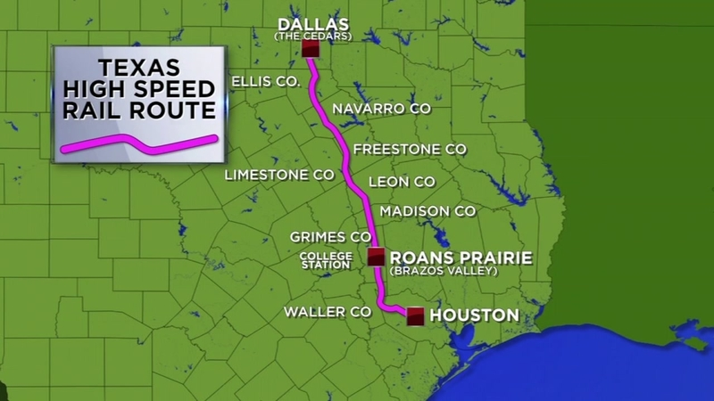
Picture Of The Route To Be Followed By The Train
Notes:
The train will pass through a number of different towns before reaching to Houston the final station before it starts the returning journey back to Dallas another major station. Before reaching the major two towns there is another station between them and the train will have to stop there before proceeding to the final destination.

Slide 12
References
Babones, S. (2018). Lone Star Shinkansen? Wide open spaces make Texas the perfect market for Japan’s bullet train.
Smith, F. J. (2018). Electric Transmission for High-Speed Rail: A Concept for a Balanced- Force Pantograph and Overhead Contact System. IEEE Vehicular Technology Magazine, 13(3), 61-71.
Barbosa, F. C. (2018, April). High Speed Rail Technology: Increased Mobility With Efficient Capacity Allocation and Improved Environmental Performance. In 2018 Joint Rail Conference (pp. V001T04A002-V001T04A002). American Society of Mechanical Engineers.

